Slide 1
Home Credit Scorecard Classification Model
Deni Yuniawan
Final Task of Project-Based Internship Home Credit Indonesia x Rakamin Academy Batch December 2024
Github : https://github.com/deniywn/rakamin-hci_pbi

Slide 2

Problem Research
Home Credit Indonesia aims to develop a model to predict the credit scores of their customers.
The dataset includes 122 columns, with one TARGET column.
Dataset sourced from PBI HCI x Rakamin Academy.

Slide 3



Objective & Goal
Objective
Goals
Business Metrics
Speed up credit score calculations using a machine learning model to avoid rejecting potential customers.
● Develop a machine learning model for credit score classification.
● Provide business recommendations.
Metric: credit score ratio

Slide 4

Data Pre-Processing
Identify and remove features with a significant amount of missing values.
Conduct univariate analysis and clean the features.
Convert the 'days' column to 'age/year'.
Transform binary categorical features into binary numerical ones.
Check the correlation among numerical features.

Slide 5
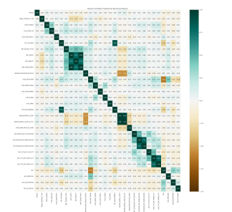
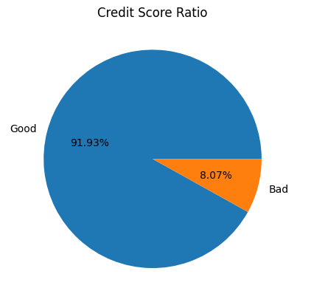
Remove features that have a zero correlation with the TARGET variable.
Eliminate features with a correlation greater than 0.6 with another feature to prevent multicollinearity.
Apply StandardScaler to non-binary numerical features.
Encode selected categorical features.
Use oversampling to handle imbalanced data.

Slide 6
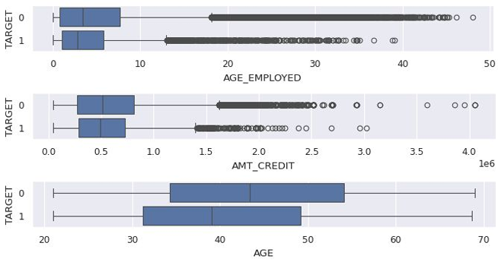

Data Visualization & Business Insight
Target value: 0 indicates good credit scores, 1 indicates bad credit scores.
Customers with higher credit amounts tend to have better scores.
Older customers and those with longer employment tend to have better credit scores, possibly due to increased maturity, responsibility, and financial stability.

Slide 7
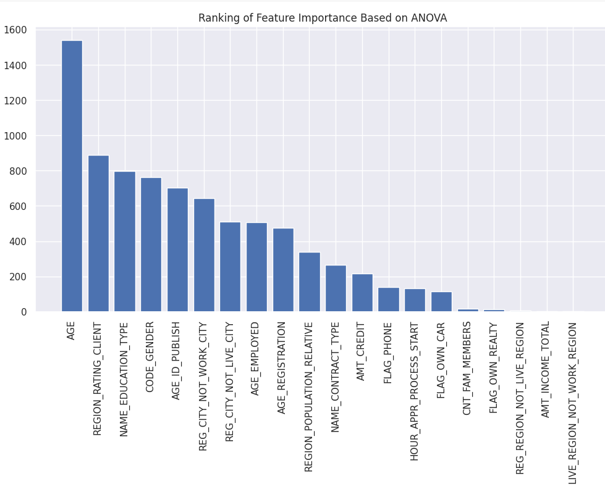
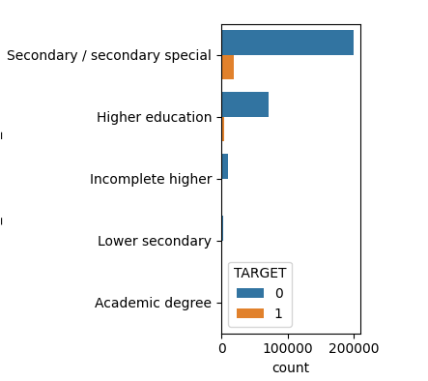
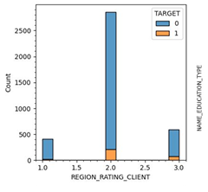
Insight
Age is the most significant feature according to the ANOVA method.
Older customers are generally more likely to have better credit scores.It is possible because most older people are more mature, responsible, and financially stable.
Other important features include region rating and education type.
Customers with education levels higher than secondary rarely have bad credit scores.

Slide 8

Machine Learning Implementation & Evaluation
Metode:
Logistic Regression
Decision Tree
Hyperparameter Tuning

Slide 9
The results
Model | Before Hyperparameter Tuning |  | After Hyperparameter Tuning
 | Accuracy (train) | Accuracy (test) | Accuracy (train) | Accuracy (test)
Logistic Regression | 65.735% | 60.047% | 65.735% | 60.047%
Decision Tree | 100% | 82.464% | 91.181% | 87.877%
For this case, decision tree with hyperparameter tuning is the best prediction model.

Slide 10

Business Recommendation
A Decision Tree model provides better results for this data.
Older individuals, experienced professionals, and those with higher education levels are more likely to have good credit scores.
Home Credit can target these customer segments to offer their products.

